Slide 1
POCUS project updates
Yiling Yang
Xiaoyang Li

Slide 2
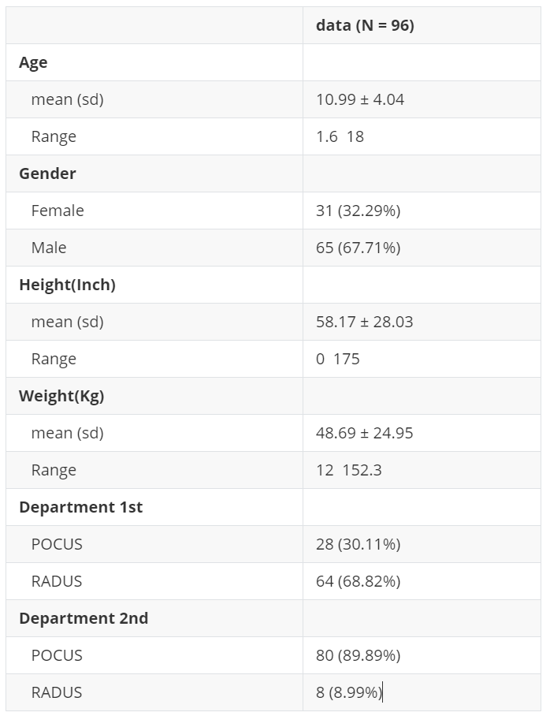
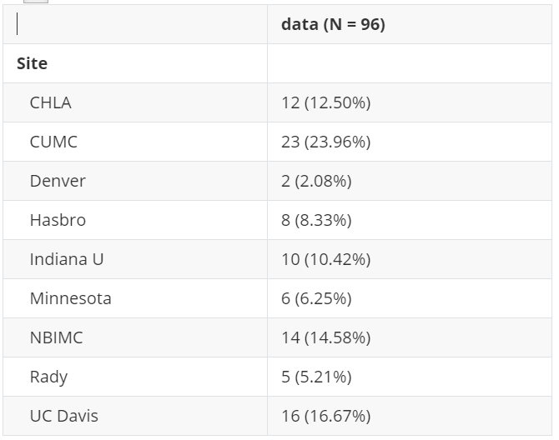
Descriptive Statistics of the subjects

Slide 3
4 x 4 confusion matrix between US 2 results and surgery findings
Table of us2_stage by surg_stage
us2_stage | surg_stage
Frequency | 1 | 2 | 3 | 4 | Total
1 | 11 | 0 | 0 | 0 | 11
2 | 21 | 7 | 0 | 0 | 28
3 | 12 | 6 | 4 | 9 | 31
4 | 2 | 1 | 0 | 2 | 5
Total | 46 | 14 | 4 | 11 | 75

Slide 4
4 x 4 confusion matrix between US 2 results and surgery findings:
Table of us2_stage by surg_stage
us2_stage | surg_stage
Frequency | 1 | 2 | 3 | 4 | Total
1 | 11 | 0 | 0 | 0 | 11
2 | 21 | 7 | 0 | 0 | 28
3 | 12 | 6 | 4 | 9 | 31
4 | 2 | 1 | 0 | 2 | 5
Total | 46 | 14 | 4 | 11 | 75
Possible explanation:
US-based decision tend to be overestimated
Antibiotic effect (We might consider about ordinal logistic regression and mixed effect model to examine this)

Slide 5
McNemar Test: Combining stages 1&2 v.s. 3&4
Table of new_us2 by new_surge
new_us2 | new_surge
Frequency | 0 | 1 | Total
0 | 39 | 0 | 39
1 | 21 | 15 | 36
Total | 60 | 15 | 75
McNemar's Test
Chi-Square | DF | Pr > ChiSq
21.0000 | 1 | <.0001
Simple Kappa Coefficient
Estimate | Standard Error | 95% Confidence Limits
0.4262 | 0.0870 | 0.2557 | 0.5968

Slide 6
McNemar Test: Combining stages 1,2, & 3 v.s. 4
Table of new_us2 by new_surge
new_us2 | new_surge
Frequency | 0 | 1 | Total
0 | 61 | 9 | 70
1 | 3 | 2 | 5
Total | 64 | 11 | 75
McNemar's Test
Chi-Square | DF | Pr > ChiSq
3.0000 | 1 | 0.0833
Simple Kappa Coefficient
Estimate | Standard Error | 95% Confidence Limits
0.1743 | 0.1476 | -0.1151 | 0.4637

Slide 7
Antibiotic effect between US 1 and US 2
Table of us2_stage by us1_stage
us2_stage | us1_stage
Frequency | 1 | 2 | 3 | 4 | Total
1 | 9 | 0 | 1 | 0 | 10
2 | 7 | 24 | 1 | 0 | 32
3 | 0 | 10 | 21 | 0 | 31
4 | 0 | 0 | 2 | 2 | 4
Total | 16 | 34 | 25 | 2 | 77
Frequency Missing = 19

Slide 8
Antibiotic effect between US 1 and US 2
Table of us2_stage by us1_stage
us2_stage | us1_stage
Frequency | 1 | 2 | 3 | 4 | Total
1 | 9 | 0 | 1 | 0 | 10
2 | 7 | 24 | 1 | 0 | 32
3 | 0 | 10 | 21 | 0 | 31
4 | 0 | 0 | 2 | 2 | 4
Total | 16 | 34 | 25 | 2 | 77
Frequency Missing = 19
Data are skewed (Only two showed lower stage at US 2) - Cannot use Logistic Regression with lowering stage at US 2 as Y - Cannot use Wilcoxon’s signed rank test, because we will have much more positive differences than negative ones (only 2) (0 will be ignored). It will be significant anyways.

Slide 9
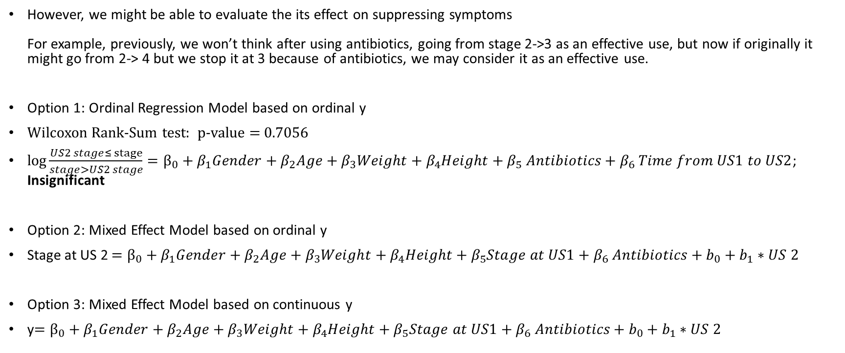
Examine antibiotic effect using Ordinal Regression Model and Mixed Effect Model
However, we might be able to evaluate the its effect on suppressing symptoms For example, previously, we won’t think after using antibiotics, going from stage 2->3 as an effective use, but now if originally it might go from 2-> 4 but we stop it at 3 because of antibiotics, we may consider it as an effective use.
Option 1: Ordinal Regression Model based on ordinal y
Wilcoxon Rank-Sum test: p-value = 0.7056
$\log{\frac{US2 stage≤ stage}{stage>US2 stage}}=β_{0}+β_{1}Gender+β_{2}Age+β_{3}Weight+β_{4}Height+β_{5} Antibiotics+β_{6} Time from US1 to US2$; Insignificant
Option 2: Mixed Effect Model based on ordinal y
Stage at US 2 $=β_{0}+β_{1}Gender+β_{2}Age+β_{3}Weight+β_{4}Height+β_{5}Stage at US1+β_{6} Antibiotics+b_{0}+b_{1}∗US 2$
Option 3: Mixed Effect Model based on continuous y
y$=β_{0}+β_{1}Gender+β_{2}Age+β_{3}Weight+β_{4}Height+β_{5}Stage at US1+β_{6} Antibiotics+b_{0}+b_{1}∗US 2$

